Slide 1

STROKE PREDICTION
CSC 580 ADVANCED PYTHON PROGRAMMING
CA2-PROJECT
DONE BY
BRINDA G (E7321004)

Slide 2
INTRODUCTION:
Cardiovascular Diseases (CVDs) are the most common cause of death globally representing 32% of all global deaths with about 17.9 million people being affected by it. Out of these, two most common CVDs are in the form of heart attack and heart stroke accounting 85% of the total people. Heart attack is caused due to blockage of oxygen or blood supply to the heart muscle while heart stroke is caused when there is blockage of the vessel feeding the brain.. Machine learning has become one of the most demanding field in modern technology. It is a form of artificial intelligence where the model can analyze the data, identify patterns and predict the outcome with minimal human intervention. Heart stroke prediction in adults can be done by using various machine learning algorithms.The factors include work type, gender, residence type, age, average glucose level, body mass index, smoking status of the individual and any previous heart disease. The proposed model predicts heart stroke prediction of several individuals using various machine learning algorithm based on these input factors which has been taken from the dataset on which the model has been trained.

Slide 3
OBJECTIVE:
The main objective of the project is to find stroke by using machine learning techniques and various algorithms . Here we analysing the accuracy level of the Model and Evaluate the model Performance to choose the best one of the several algorithms . By using this method we can predict the stroke of the patient by observing their symptoms like age , gender , blood pressure , sugar level , body mas index, etc.

Slide 4
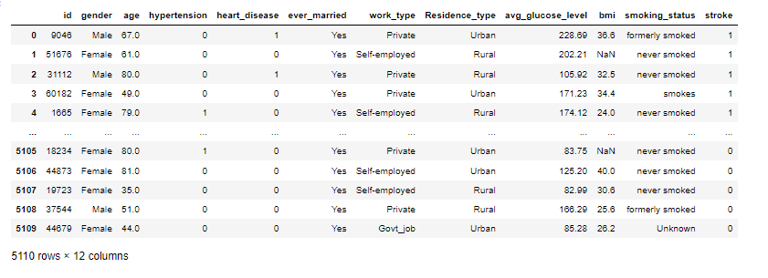
DATASET DESCRIPTION
The dataset has been taken from the Kaggle website. It has 5110 rows and 12 columns. The features or attributes include id, gender, age, hypertension, heart disease, ever married, work type, residence type, average glucose level, body mass index (BMI), smoking status. The label or the outcome is stroke . The independent attributes are stored in the X variable while the dependent attribute which is the stroke attribute is stored in the y variable .

Slide 5
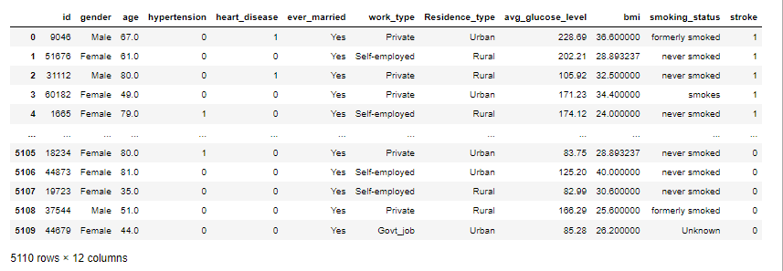
DATA PREPROCESSING
The dataset obtained contains 201 null values in the BMI attribute which needs to be removed. Presence of these values can degrade the accuracy of the model. The numerical values are involved in standardization of the attributes. The cleaned pre-processed data is shown below.

Slide 6
EXPLORATORY DATA ANALYSIS
Stroke prediction is analyzed using various machine learning algorithms . The analysis of the features has been done by using univariate and multivariate plots to obtain the correlation between the several features.
Data visualization helps to interpret the data easily through visual graphs or maps. Heatmaps are used to obtain the correlation between the attributes. Histogram plots are used to count the frequencies of smokers and non-smokers, number of females or males, the different work types of the people .Box plots have been used to indicate the relationship between two attributes and find out the outliers. All these plots give important insights about the data which can later be used for the modelling. It also shows which features are more important in making the most accurate prediction.

Slide 7
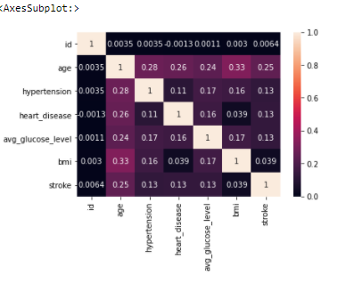
HEAT MAP
Heat amp is used to show the corelation between the variables.
Dark colour implements no correlation.

Slide 8
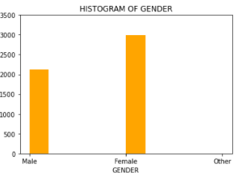
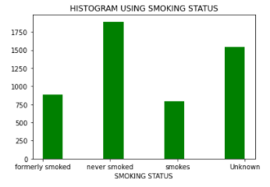
HISTOGRAM
The Histogram Using Gender Represents that the Female Count is More than the Male Count.
The Histogram Using Smoking status Represents that Count is More in Never Smoked person than the Count of the Smokers.

Slide 9
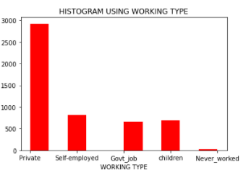
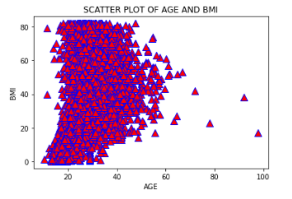
The Histogram Using Work type Represents that Count is More in Private jobs than the Count of the Government job and Self Employed.
SCATTER PLOT
The Scatter plot is Between the Age and BMI which shows
that the BMI is more in the age of below 50.

Slide 10
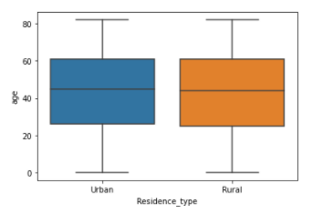
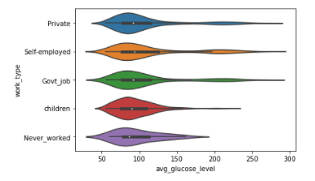
BOX PLOT
The Box plot for Residency Type and
Age determines That Both Urban and
Rural Area having median of people
above 40.
VIOLIN PLOT
The Violin plot For Average glucose level
and Work type Determines that the level of
glucose lies more in 50 to 100 for most of
the people in every job type

Slide 11
FINAL MODEL
Logistic Regression- It is a method to predict a dependent variable given a set of independent variables such that dependent variable is categorical. The dependent vs independent variable is mapped to a sigmoid function. So, value of dependent variable is found either 0 or 1 for any value of independent variable. It gives the probability of occurrence of an event and several results like accuracy, ROC curve, F1 score, precision, recall, confusion matrix can be obtained from logistic regression.
DATA SPLITTING
The dataset is split into dependent and independent attributes using the train test split method of sklearn package in python. The dataset is split into 80% for training and 20% for testing. The independent features include all the input parameters like age, gender, bmi, smoking status, while the dependent feature is stroke.

Slide 12
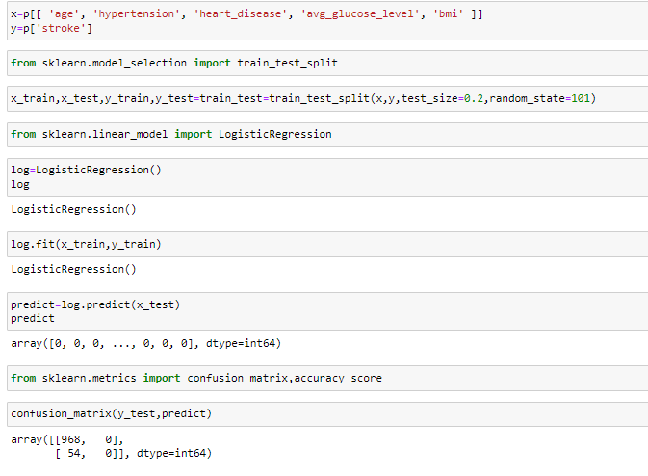

MODEL

Slide 13
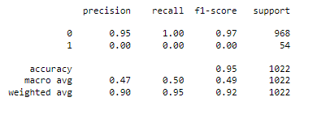
INTERSTING FINDING FROM THE MODEL
The results obtained after applying Logistic Regression .The metrics used to carry out performance analysis of the algorithm are Accuracy score, Precision (P), Recall (R) and F-measure. Precision metric provides the measure of positive analysis that is correct. Recall defines the measure of actual positives that are correct. F-measure tests accuracy.
Precision = (TP)/(TP+FP)
Recall = (TP)/(TP+FN)
F1-Measure = ( 2 * Precision * Recall )
The Model Accuracy
is 95 %

Slide 14
CONCLUSION
As heart diseases and strokes are increasing rapidly across the world and causing deaths, it becomes necessary to develop an efficient system that would predict the heart stroke effectively before hand so that immediate medical attention can be given. In the proposed system, the most effective algorithm for stroke prediction was obtained Using Logistic Regression with accuracy score of 95%.
FUTURE WORK
The project can be further enhanced by deploying the machine learning model obtained using a web application and a larger dataset could be used for prediction to give higher accuracy and produce better results.

Slide 15
THANK YOU

